Slide 1


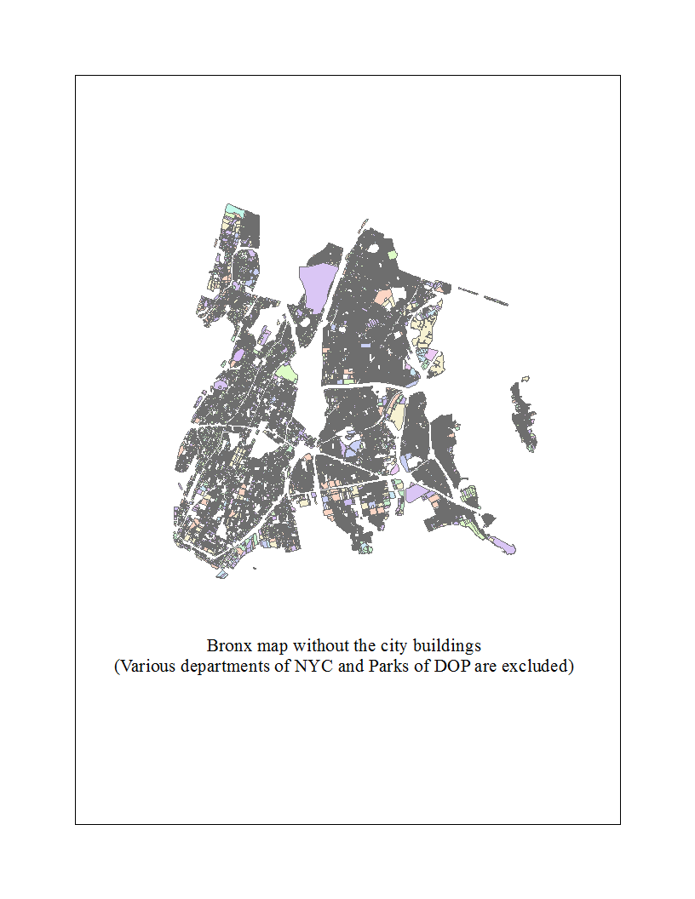
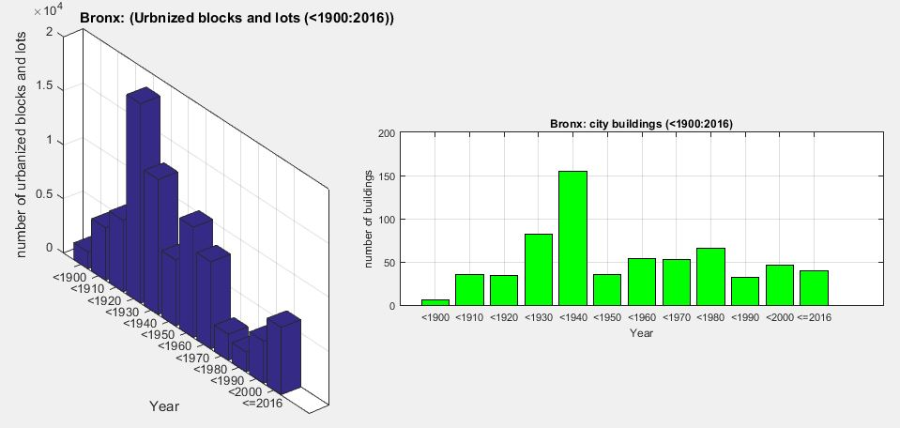
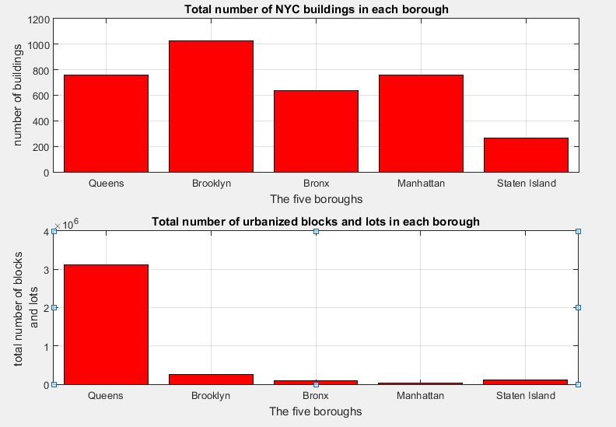
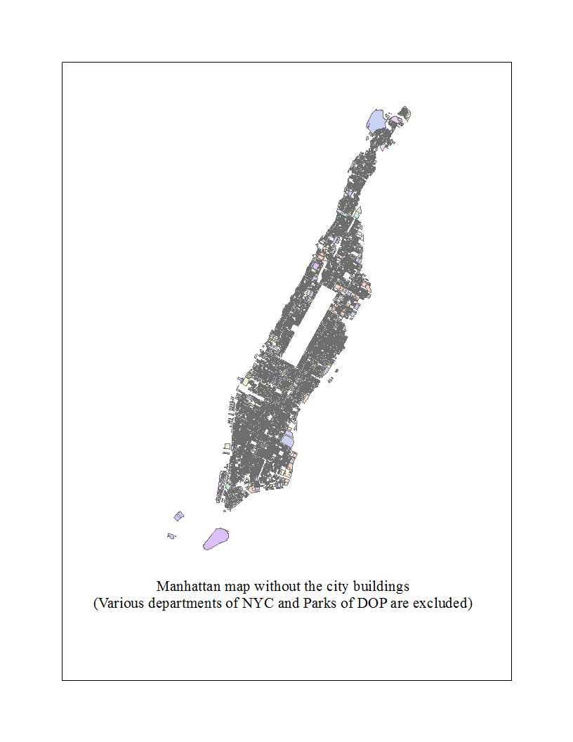
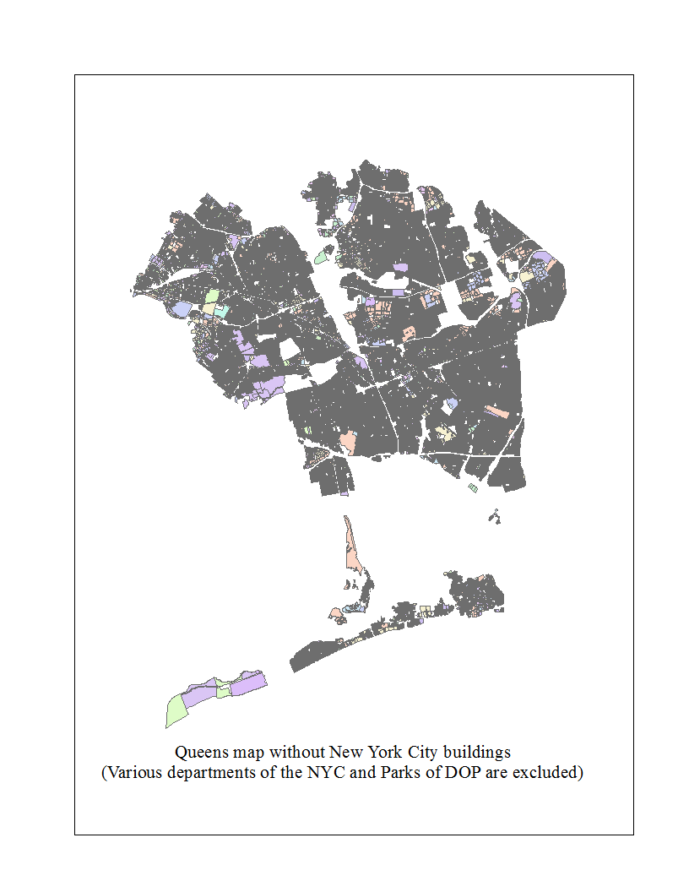
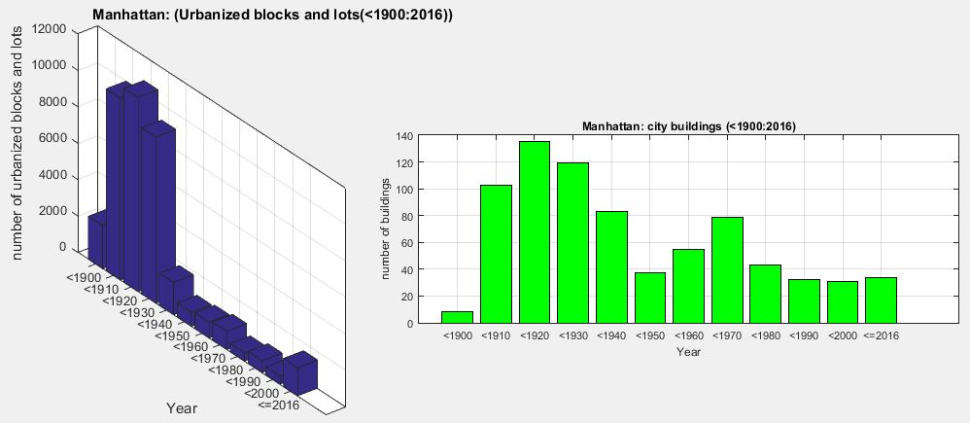
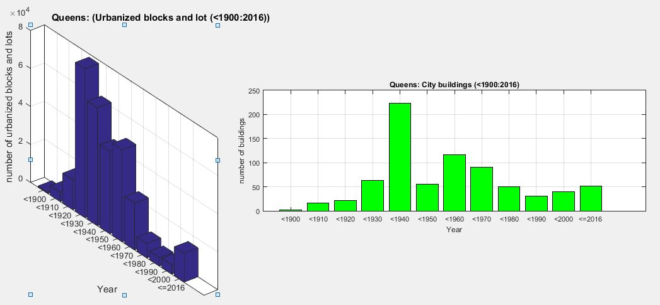
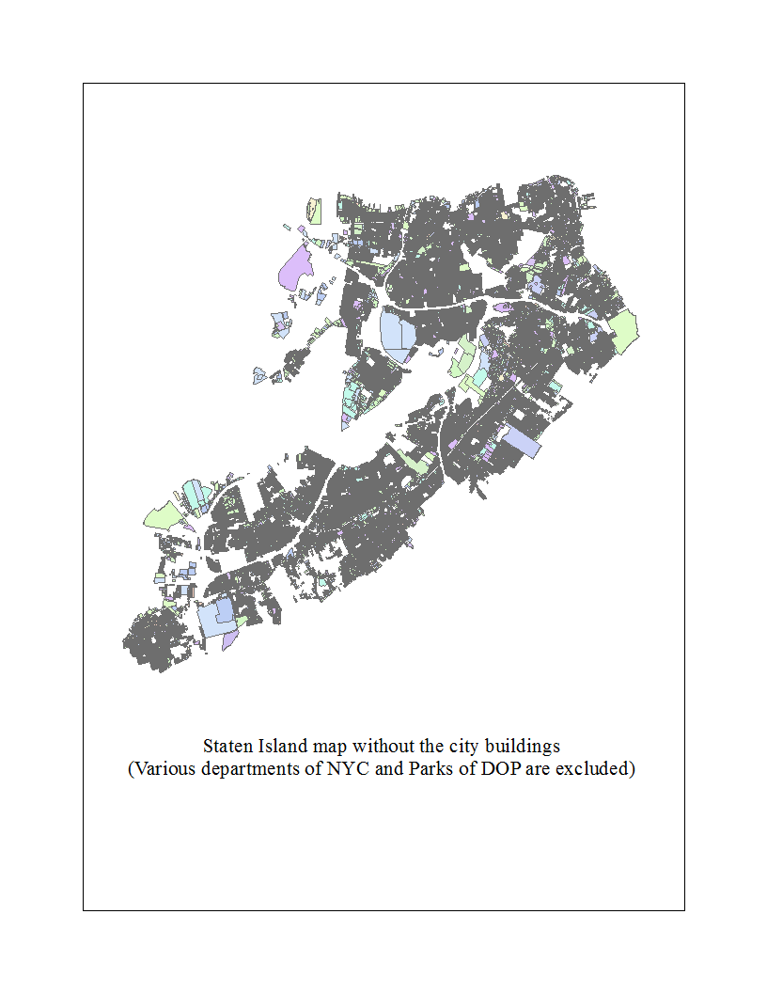
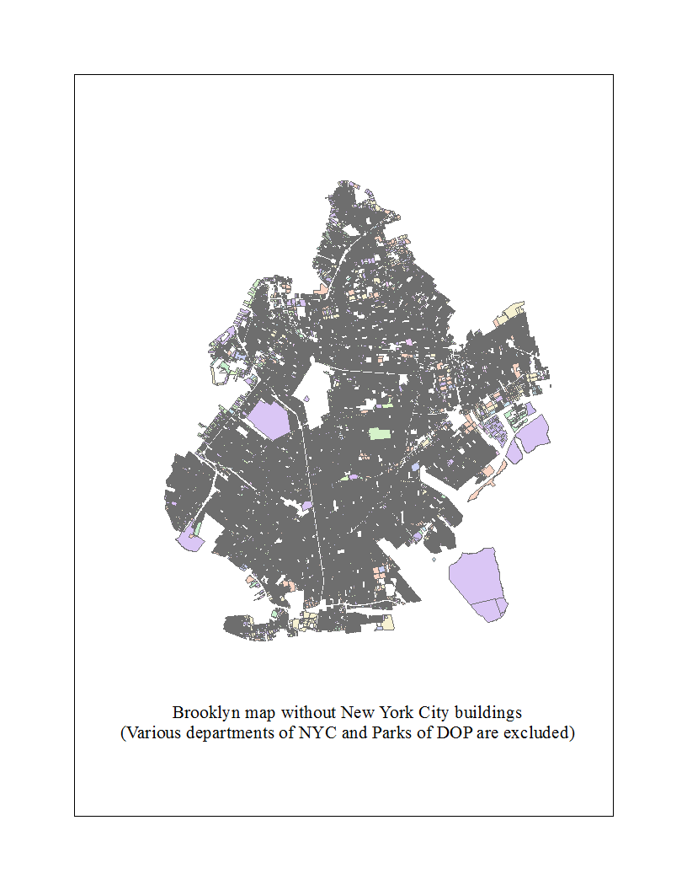
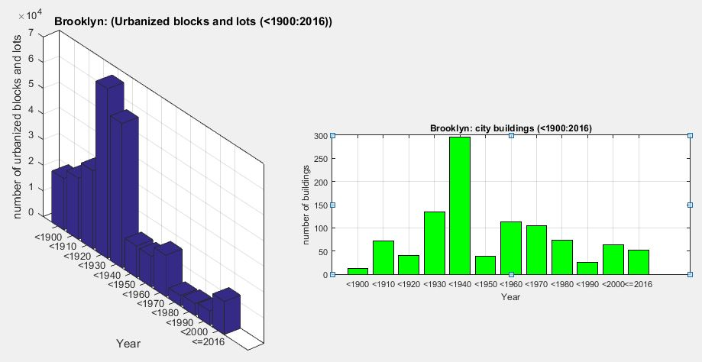
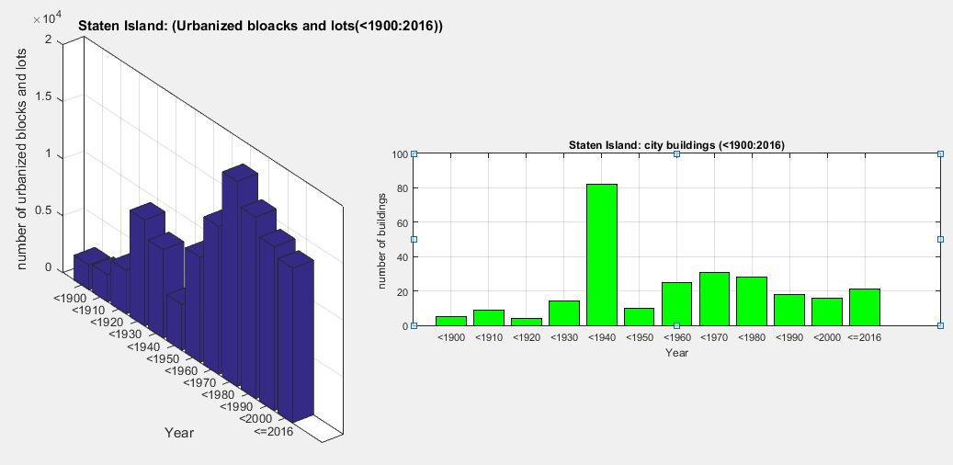
Urbanization in New York City
Samuel Youssef; Prof. Alan I. Benimoff Ph.D., City University of New York, College of Staten Island
abstract
Analysis
This study explores urbanization in New York city. In the study, we partitioned the urbanization map of the five boroughs (Brooklyn, Manhattan, Bronx, Queens, and Staten Island) into 12 time intervals. Each of the 12 intervals represents a 10-year long geographical developments of New York city starting from 1900 until our present time. The study excluded the city buildings including the department of parks and recreation facilities. The study found that the most urbanization happened in the borough of Queens. Those urbanized blocks and lots represent schools, hospitals, higher education institutions, transportation facilities, private homes, public facilities, private businesses…etc. Also we have found that Manhattan contains the least number of urbanized blocks and lots. The number of city buildings including parks which belong to the department of parks and recreation (DOP) was the highest in the borough of Brooklyn. On the other hand, the number of excluded blocks and lots in the borough of Staten Island was the lowest. the study has found that the climax of development in all five boroughs was over the time interval between 1910 and 1950. The detailed information about the stages of urbanization in each of the five boroughs were analyzed and graphed accordingly.
After analyzing the graphs and the maps of each borough, we calculated the total number of urbanized blocks and lots in each one of the five boroughs. Also, a similar type of calculations was done on the excluded departments and buildings of New York city including parks of the Department of Parks and Recreation. Bar graphs which incorporate totals of each borough in both comparisons discussed are graphed and shown below.
Bronx
Boroughs and their maps:
Manhattan
Queens:
Conclusion
Queens: The climax of urbanization in this borough happened between 1920 and 1950. Queens has the largest number of urbanized blocks and lots among the five boroughs.
Brooklyn: the climax of urbanization in this borough happened between 1910 and 1940. Brooklyn has the largest number of NYC building and departments among the five boroughs.
Bronx: the climax of urbanization in this borough happened between 1910 and 1940.
Manhattan: the climax of urbanization in this borough happened between 1910 and 1930. Manhattan has the least number of urbanized blocks and lots among the five boroughs.
Staten Island: the climax of urbanization in this borough started in 1960 and the number of urbanized blocks and lots is still growing. The unconventional increased rate of urbanization in our present time is solely a result of the construction of the Verrazano bridge which connected the main body of NYC with the island. The bridge opened in November 21, 1964, which explains the noticeable jump in urbanization Staten Island witnessed in the 1960s. Staten Island has the least number of NYC buildings and departments among the five boroughs.
* Data were obtained and analyzed from NYC PLUTO database.
Brooklyn
Staten Island

